Slide 1
Semantic search for concepts using linear model coefficient vectors
Robert Horton, PhD <rhorton@win-vector.com>
John Mount, PhD <jmount@win-vector.com>
Jerry Lau, PharmD <jerry@phactmi.org>
Katherine Gundling, MD <katherine.gundling@ucsf.edu>
https://github.com/rmhorton/PMC_classifiers

Slide 2
Technical Takeaways
Semantic embeddings
Capture the meaning of text in fixed-length numeric vectors
Turn NLP problems into geometry problems: similarity & prediction
Coefficient vectors
Represent abstract concepts in semantic space.
Prediction (model scoring) can be framed as similarity search.
Models as data
Similarity search is scalable (FANN).
Label Mining
Build upon existing captured human judgement in Pubmed
Section heading patterns
Key terms (MeSH)
Transfer learning
Will models trained on PMC data work for you?
Notes:
There are a lot of parts here: ML on semantic embeddings in the context of the remarkable Pubmed dataset

Slide 3
Outline
Training ML models on Pubmed data
ML = predicting labels from features
Features from semantic embedding
Labels from section heading patterns or MeSH terms
Mini-demo walkthrough
RMarkdown document with demo dataset
Logistic regression with cv.glmnet
Representing concepts as coefficient unit vectors
Prediction as search
Engineering labels by refining section heading patterns (Jerry)
Scaling up on postgres
pgvector: vector search in SQL
Predicting MeSH terms (Katherine)
Finding new topics in old articles
Notes:
Training ML models: semantic embeddings are not just for similarity searching; they also make great predictive features. But where do labels come from? We show two ways to get labels from Pubmed/PMC.
Mini-demo: download and run this RMarkdown document and accompanying dataset.
Engineering labels: Jerry discusses why we want these models, and how we can tune the patterns to better match our needs.
Scaling up on postgres: Bob shows how the SQL database helps us deal with larger data.
Predicting MeSH terms: Katherine discusses how models trained on new MeSH terms can be used to find relevant articles in older literature (to which these new terms have not been applied). This is like transfer learning to the past.

Slide 4
Introduction Training ML models on Pubmed data
Robert Horton, PhD
https://github.com/rmhorton/PMC_classifiers
Download the mini-demo zip file from Google Drive

Slide 5
Pubmed Free database of biomedical and life sciences literature https://pubmed.ncbi.nlm.nih.gov/download/ Pubmed Central (PMC) Free full-text archive of biomedical and life sciences journal literature from the National Institutes of Health's National Library of Medicine (NIH/NLM) ftp.ncbi.nlm.nih.gov/pub/pmc/oa_bulk/oa_comm/xml/
No librarians were harmed in the production of this demo

Slide 6
Semantic Embeddings
from sentence_transformers import SentenceTransformer model = SentenceTransformer("all-mpnet-base-v2") embeddings = model.encode(sentences)
sbert.net
(We promise this is the only Python code we will show you today.)
Notes:
You can also get embeddings by calling web services, like those offered by OpenAI.

Slide 7
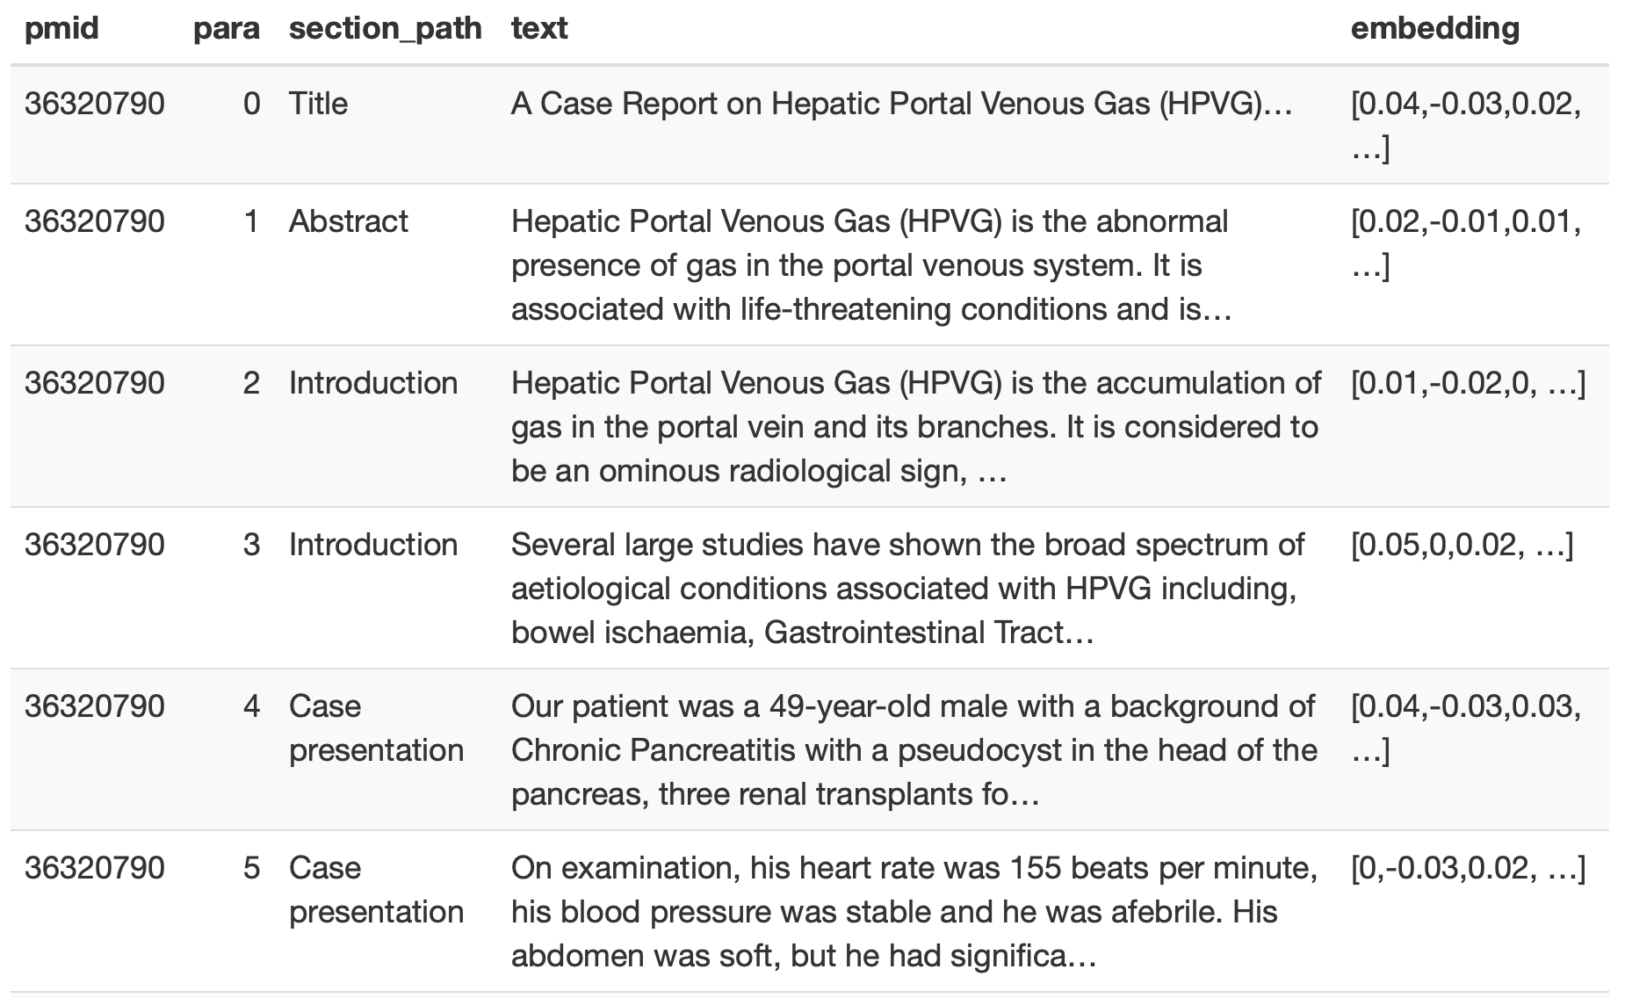
Notes:
Section headers are descriptive metadata about the paragraphs in that section. Here the authors are telling us which paragraphs represent the abstract, introduction, etc.
The embeddings were generated by running the paragraph text (not including the section headers) through a sentencetransformer model.
'Title' is a pseudo section path; the first 'paragraph' in every article is the title.

Slide 8
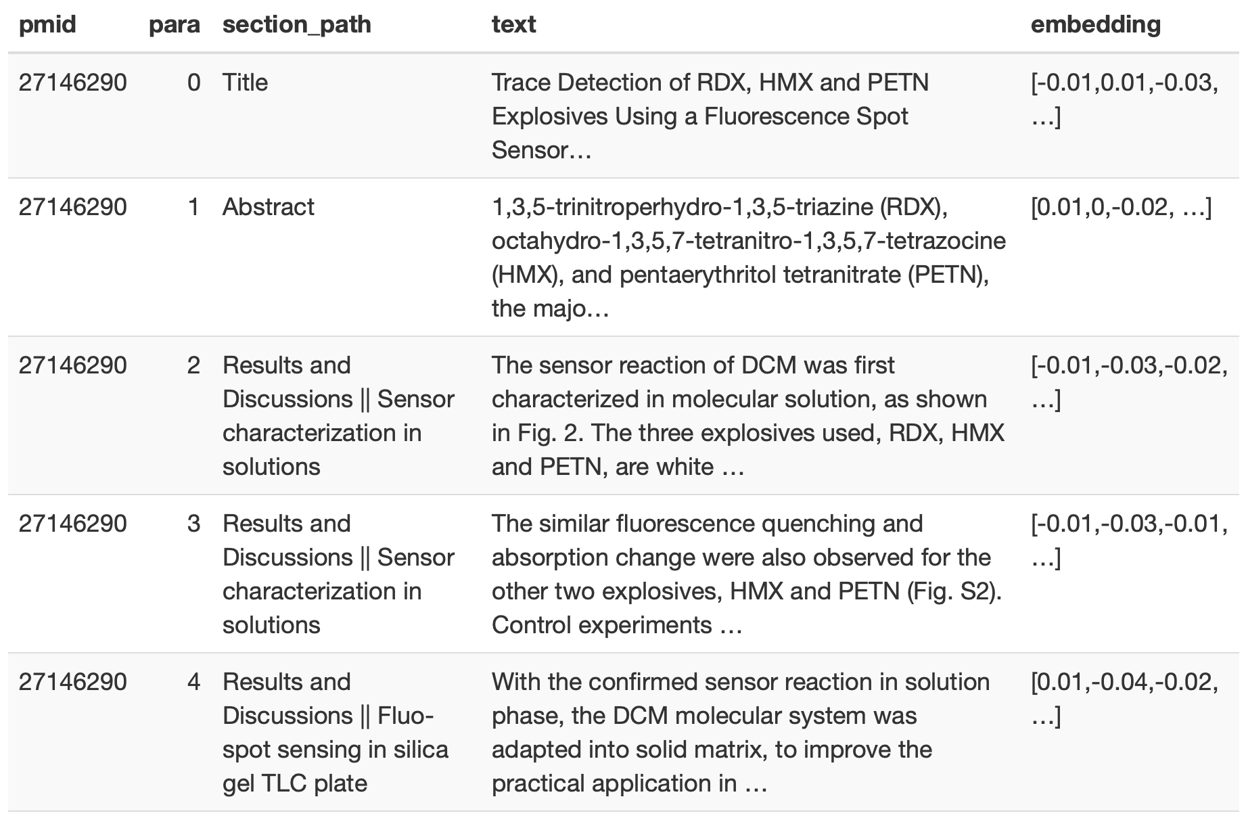
Notes:
Sections can have subsections. These are indicated by concatenating the whole path of headings to get to the subsection.
Not all papers in PMC are medical. This one is about detecting explosives.

Slide 9
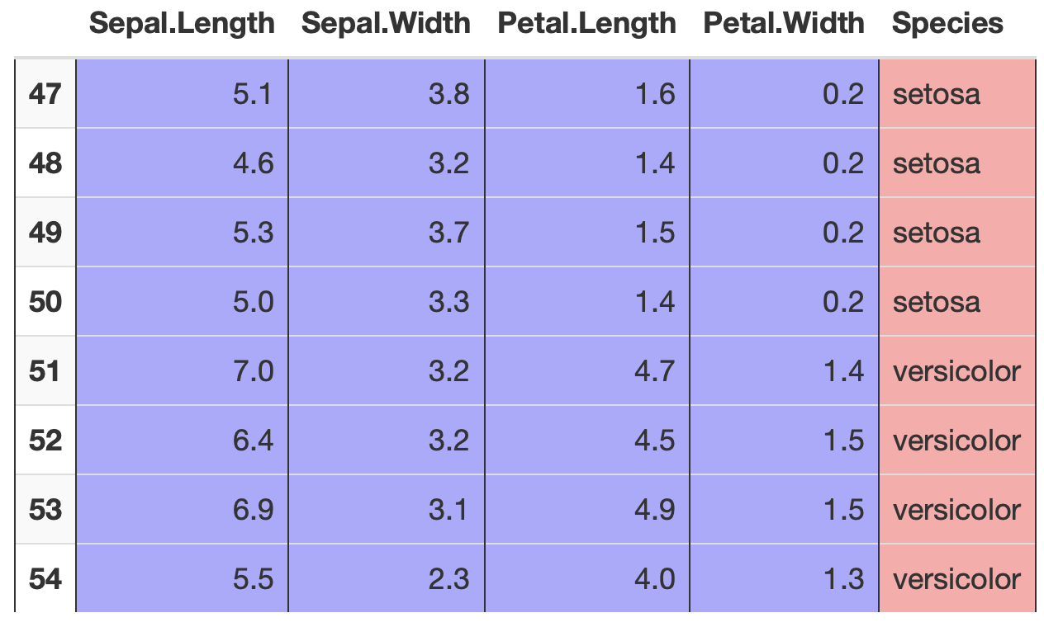
Machine Learning: use FEATURES to predict LABELS
Notes:
We need data in this format.

Slide 10
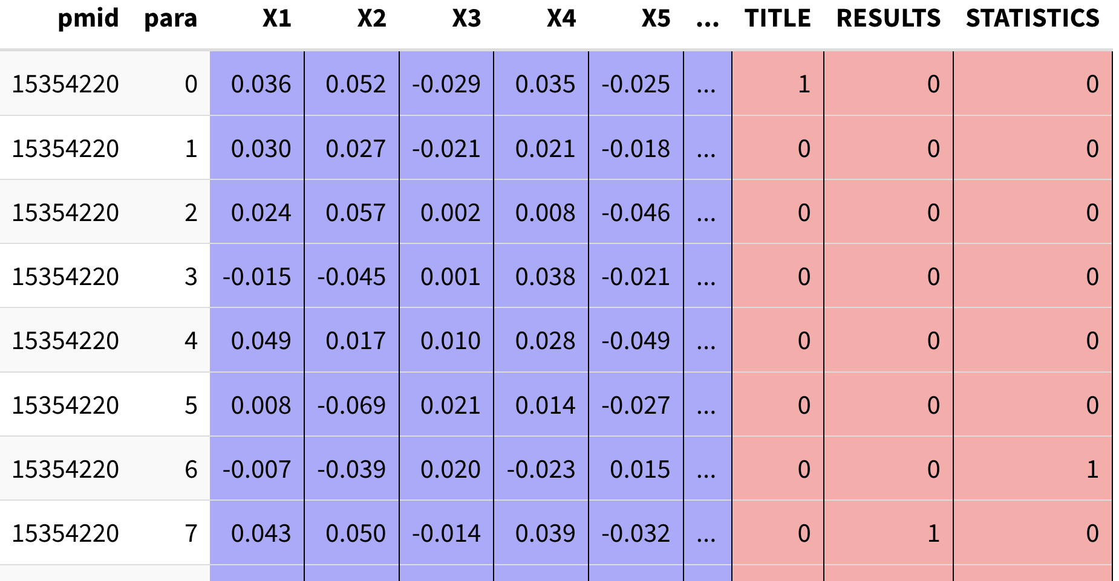
Notes:
The features are the individual dimensions of the semantic embedding and the labels are boolean flags. Here the labels are from matching regular text patterns to the section headings.
We will train a separate model on each label.

Slide 11
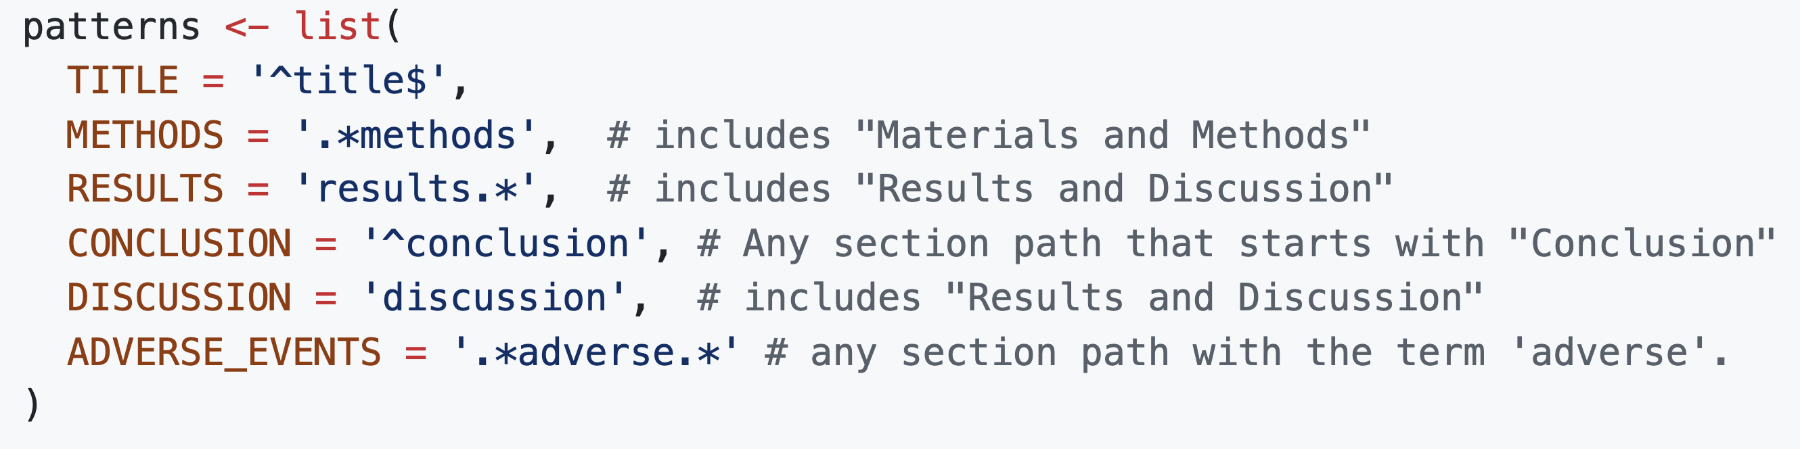
Engineering labels by matching patterns in section headings
These are the simple patterns from the mini-demo.
Later we will explore how to make them more precise.

Slide 12
Mini-demo Walkthrough
https://github.com/rmhorton/PMC_classifiers
In the mini_demo directory, download
the RMarkdown document and the five datafiles in demo_data
or
Download the zip file from Google Drive

Slide 13
R demo outline
Quick vertical slice of semantic search
Predicting section heading patterns in a small(ish) dataset.
All in R, no database. Try it at home!
cross-validated logistic regression with cv.glmnet()
This is a normal logistic regression using hyperparameter tuning with cross-validation
Coefficient unit vectors
it is common to normalize vectors to unit length because this makes cosine similarity or correlation easier to compute (with an inner product)
search by coefficient vector only really works if semantic vectors are normalized to unit length
normalizing the coefficient vectors makes them the same kind of thing as data
concepts summarize relationships between cases -> we can also study relationships between concepts

Slide 14
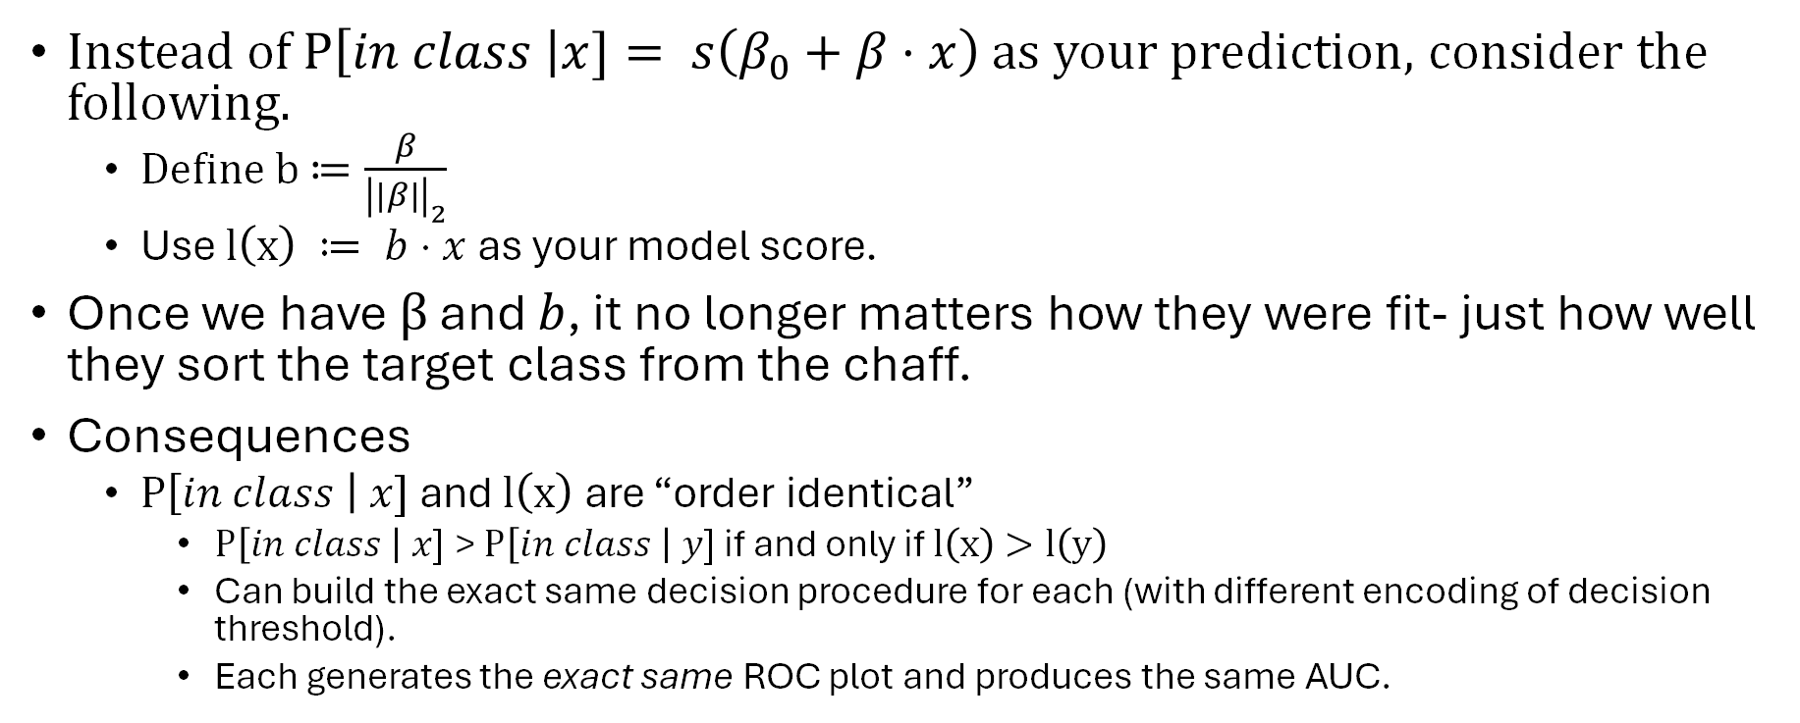
A Cool Trick
Instead of $P\left[in class \right|x]= s\left(β_{0}+β⋅x\right)$ as your prediction, consider the following.
Define b$≔\frac{β}{{\left|\left|β\right|\right|}_{2}}$
Use $l\left(x\right) ≔ b⋅x$ as your model score.
Once we have $β$ and $b$, it no longer matters how they were fit- just how well they sort the target class from the chaff.
Consequences
$P\left[in class \right| x]$ and $l\left(x\right)$ are “order identical”
$P\left[in class \right| x]$ > $P\left[in class \right| y]$ if and only if $l\left(x\right)>l\left(y\right)$
Can build the exact same decision procedure for each (with different encoding of decision threshold).
Each generates the exact same ROC plot and produces the same AUC.

Slide 15
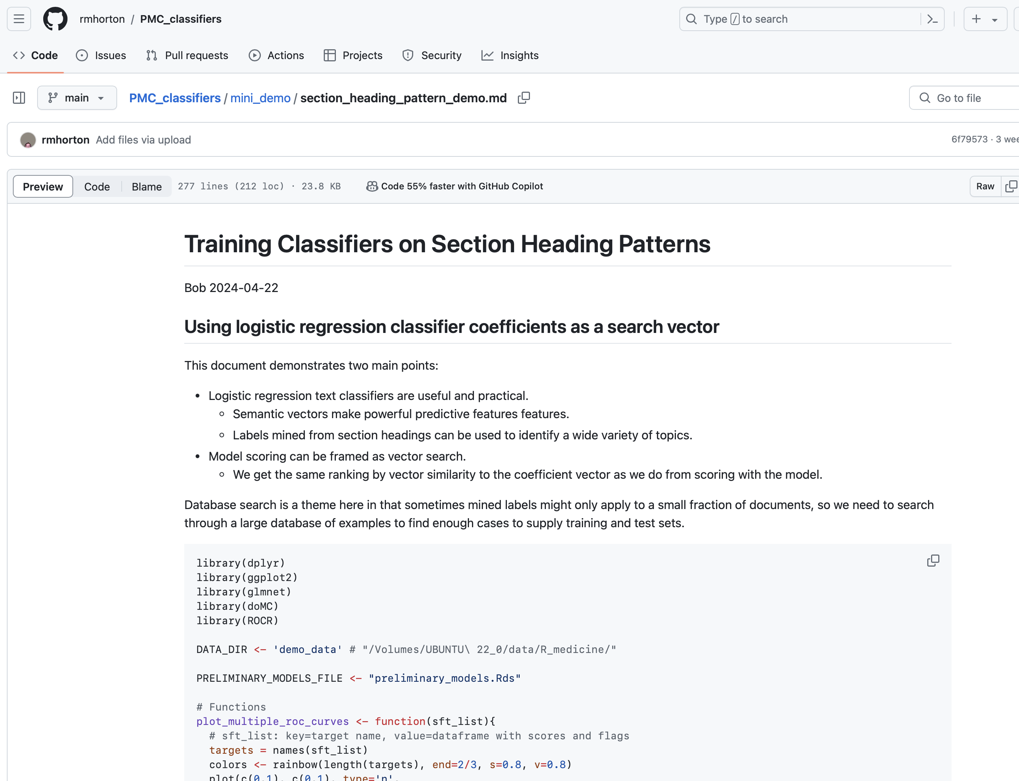
https://github.com/rmhorton/PMC_classifiers

Slide 16
Engineering Labels by refining section heading patterns
Jerry Lau, Pharm D

Slide 17

Scientific Response Documents (SRDs)
SRDs are the pharmaceutical industry's response to unsolicited inquiries from healthcare providers that can extend beyond the product labeling
They are non-promotional, evidence-based, and scientifically balanced, conforming with internal procedures and the FDA Guidance on Responding to Unsolicited Requests for Off-Label Information
PhactMI is a nonprofit composed of Medical Information departments that create these documents
Notes:
How --> why (include a detailed rubric)
Scoring guide --> how human evaluators would grade an SRD
How to automatcialy score SRD that may have been writeen by GPT X

Slide 18
Criteria for Evaluating SRDs
PhactMI developed best practices guidelines on creating SRDs
Extended this research into creating a rubric
Rubric Purpose: To quantitively evaluate an SRD based on the best practices recommended by PhactMI
Rubric originally intended for human evaluation
Take that rubric and use it as a framework for having computers evaluate SRDs
Overarching Goal: Have a tool that can help human writers develop SRDs

Slide 19
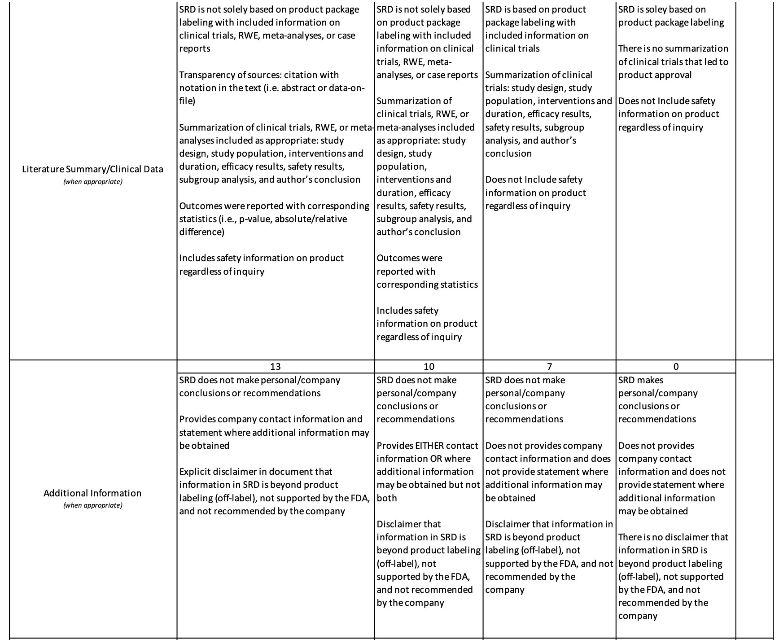
Rubric
Some of the rubric criteria might be addressable with classifiers.

Slide 20
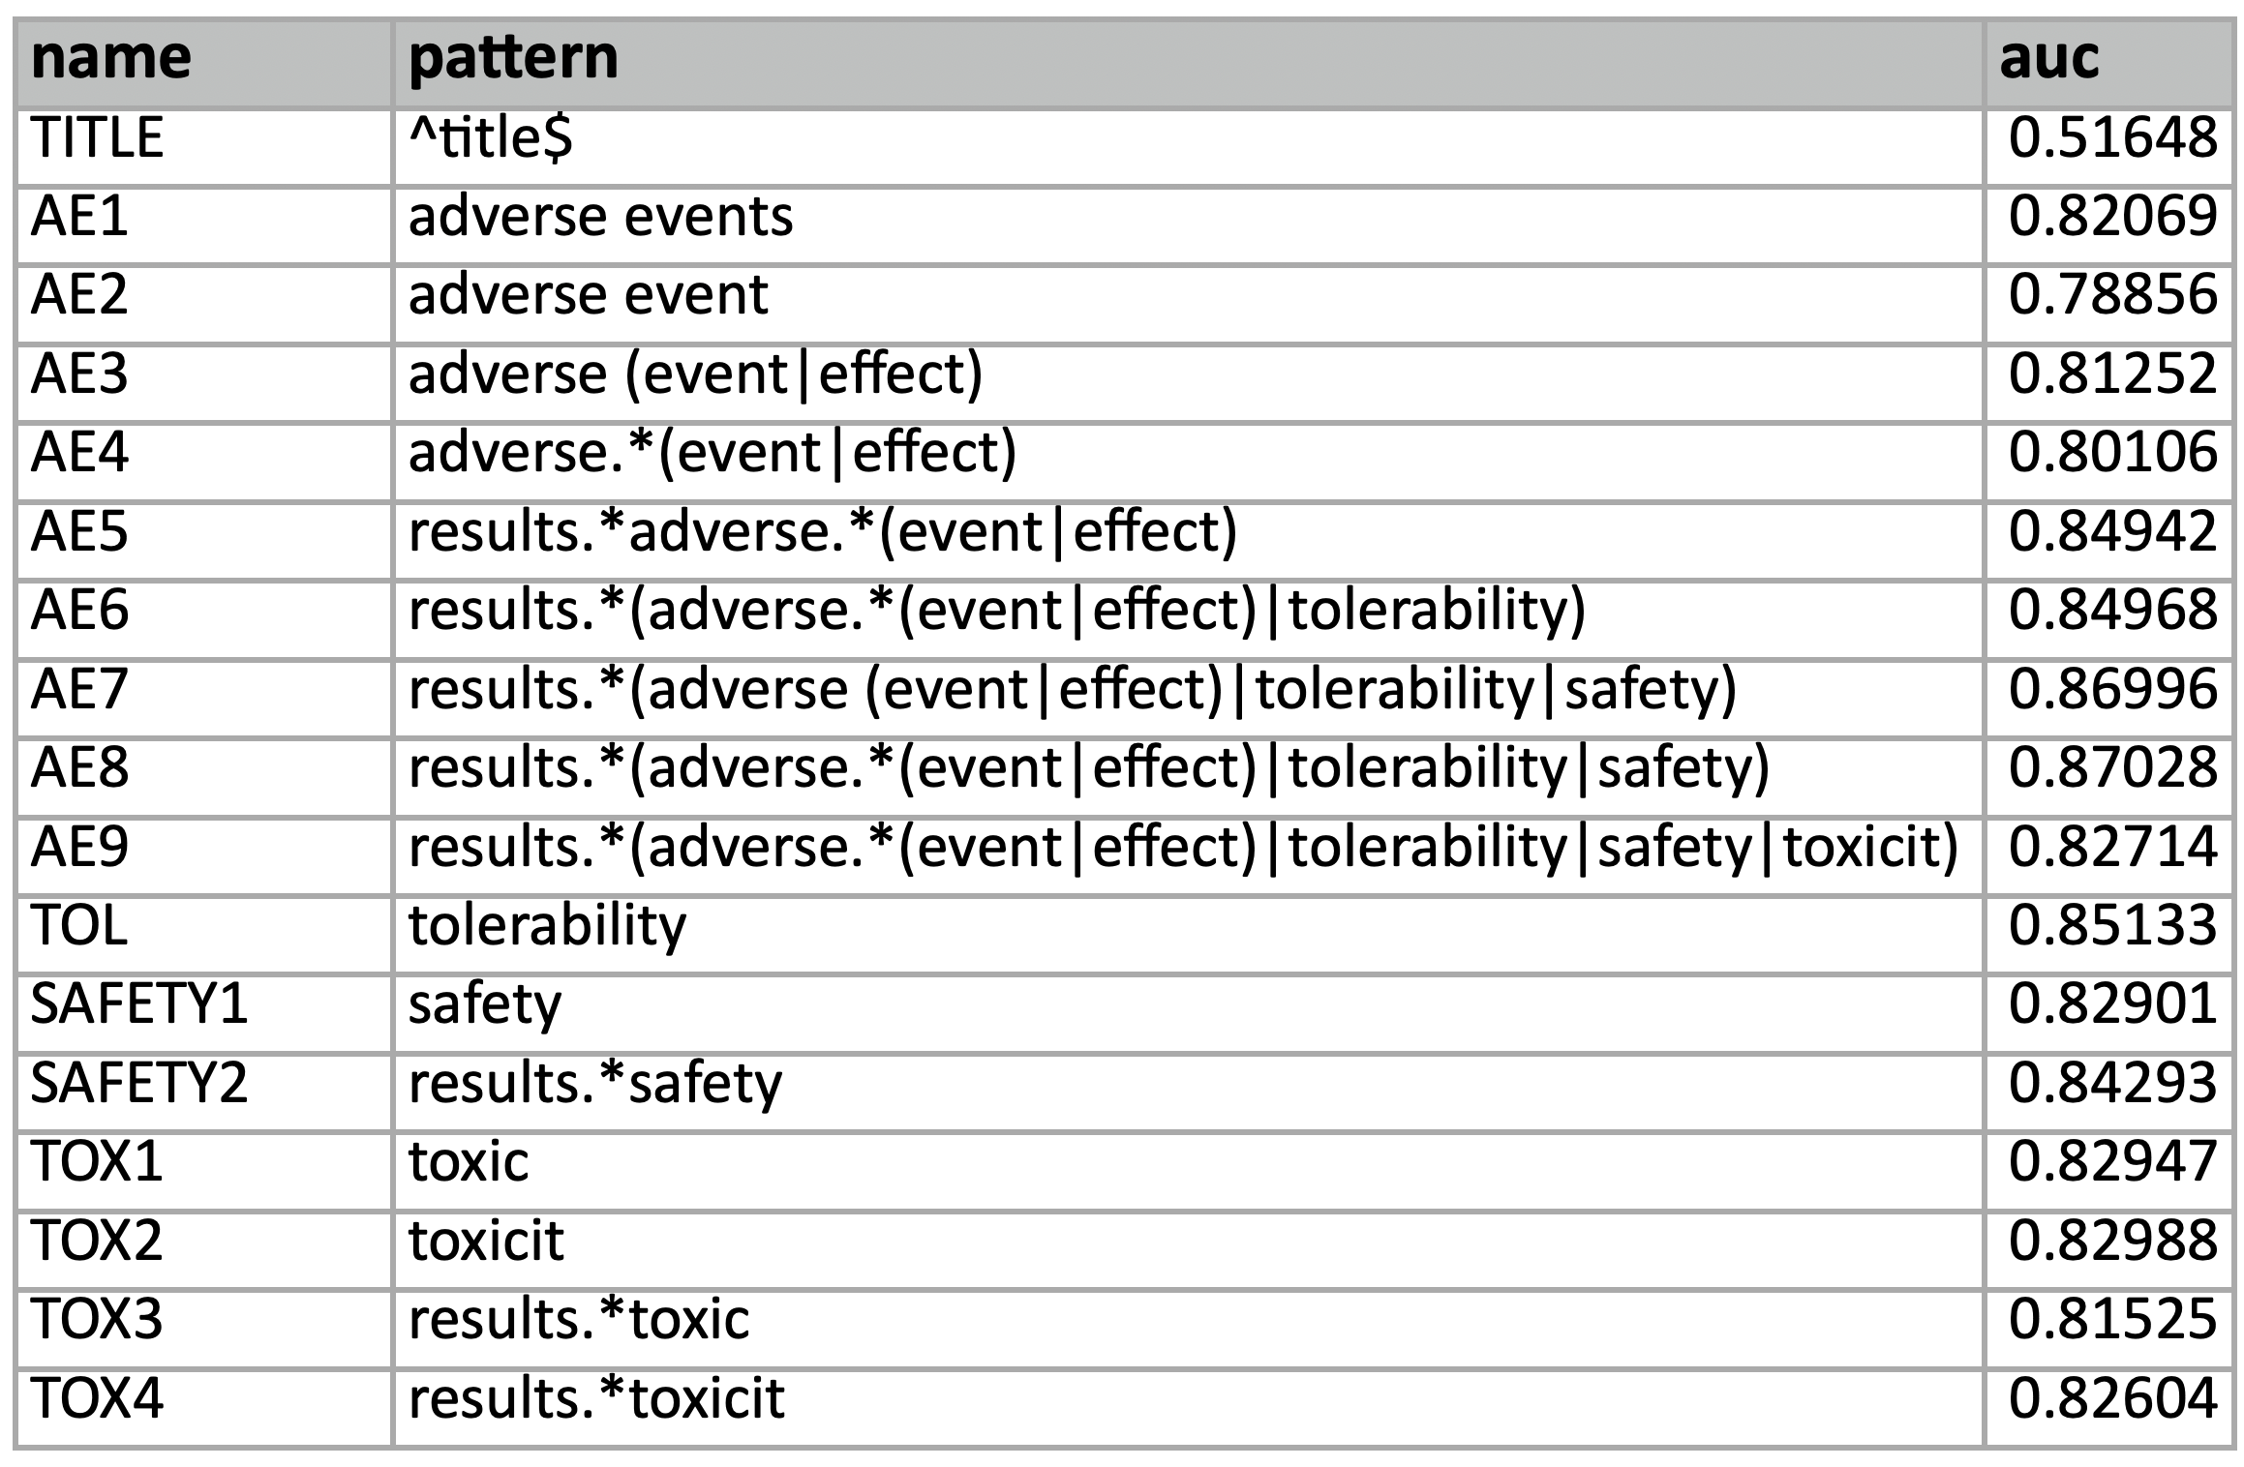
Performance of pattern models on a test set hand-labelled for adverse events
Notes:
It helps to focus on the results section.
Adding tolerability didn't make much difference, but it didn't hurt. We left it in because subsections of results talking about tolerability were generally on target.
Adding safety helped quite a bit. <- This is our best model, and it beats the ones we trained earlier so laboriously on Prodigy
Adding toxicity made it worse. This looks like it is because 'toxicity' covers things like cytotoxicity experiments unrelated to clinical trials.

Slide 21
Tagging Elements
Adding elements for sections/subsections such as safety, tolerability, or toxicity to capture all adverse events found passages that were not related to what we were trying to capture
i.e. 'Toxicity' element brought up tagged passages that had no direct correlation to adverse events caused by a drug (e.g. cytotoxicity)
Notes:
ideal example: things in the rubric that a classifier can handle. srd has adverse events --> we can use classifier for that.

Slide 22
Scaling up on PostgreSQL
Robert Horton, PhD

Slide 23
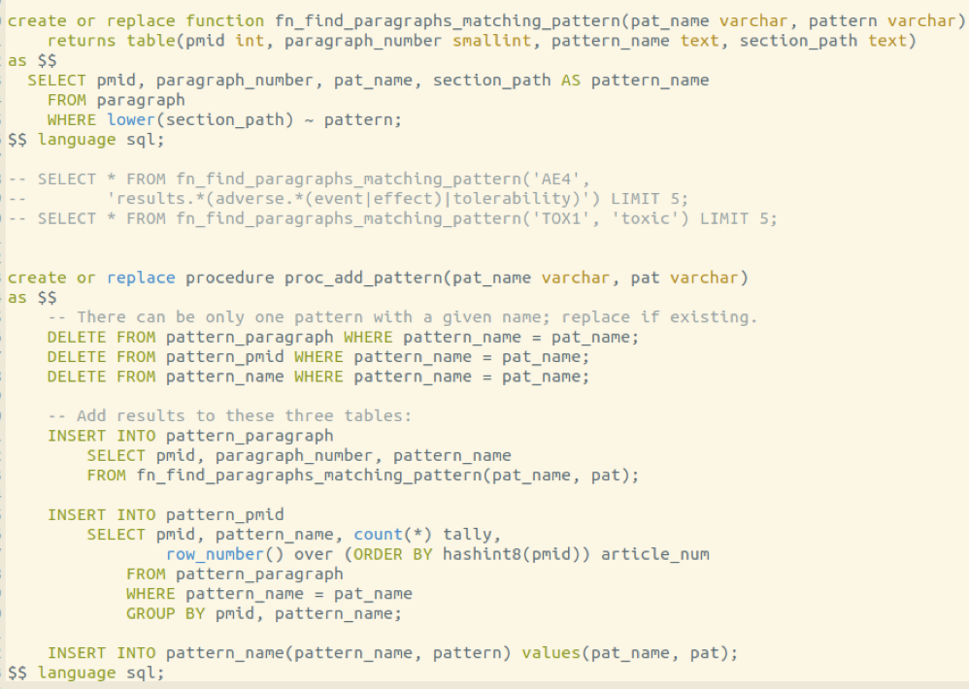
Regular expression pattern matching operator
Functions can manage tables
Functions can call other functions

Slide 24
Find all the patterns
patterns <- c(
AE1 = 'adverse events',
AE2 = 'adverse event',
AE3 = 'adverse (event|effect)',
AE4 = 'adverse.*(event|effect)',
AE5 = 'results.*adverse.*(event|effect)',
AE6 = 'results.*(adverse.*(event|effect)|tolerability)',
AE7 = 'results.*(adverse (event|effect)|tolerability|safety)',
AE8 = 'results.*(adverse.*(event|effect)|tolerability|safety)',
AE9 = 'results.*(adverse.*(event|effect)|tolerability|safety|toxicit)',
)
for (pat_name in names(patterns)){
pattern <- patterns[pat_name]
sql <- sprintf("call proc_add_pattern('%s', '%s');", pat_name, pattern)
print(sql)
dbExecute(con, sql)
}

Slide 25
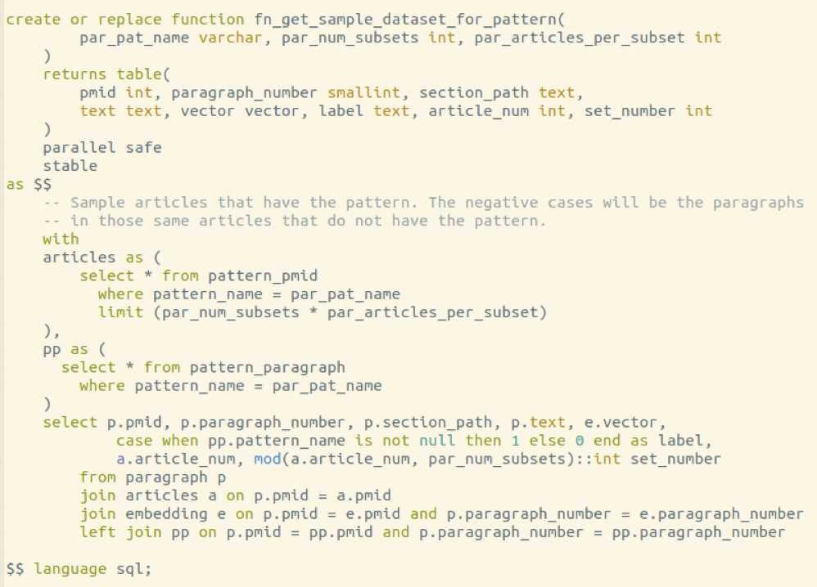
Custom training set for each pattern
We have already found all the patterns
We have already computed all the embeddings

Slide 26
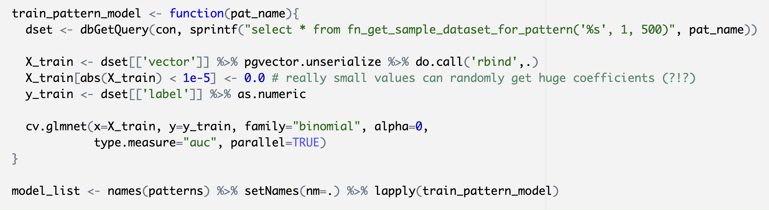
Train all the pattern models

Slide 27
Performance of pattern models on a test set hand-labelled for adverse events
Notes:
It helps to focus on the results section.
Adding tolerability didn't make much difference, but it didn't hurt. We left it in because subsections of results talking about tolerability were generally on target.
Adding safety helped quite a bit. <- This is our best model, and it beats the ones we trained earlier so laboriously on Prodigy
Adding toxicity made it worse. This looks like it is because 'toxicity' covers things like cytotoxicity experiments unrelated to clinical trials.

Slide 28
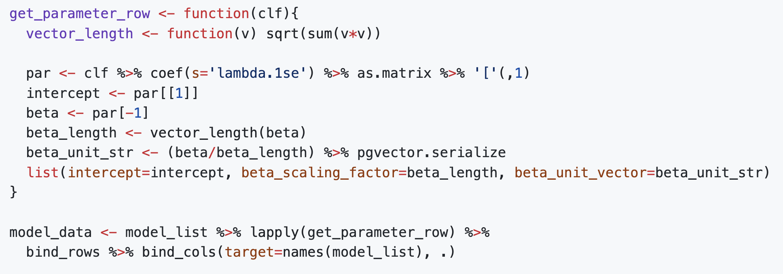
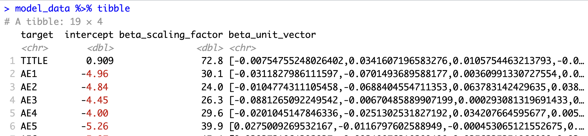
Extract model data

Slide 29
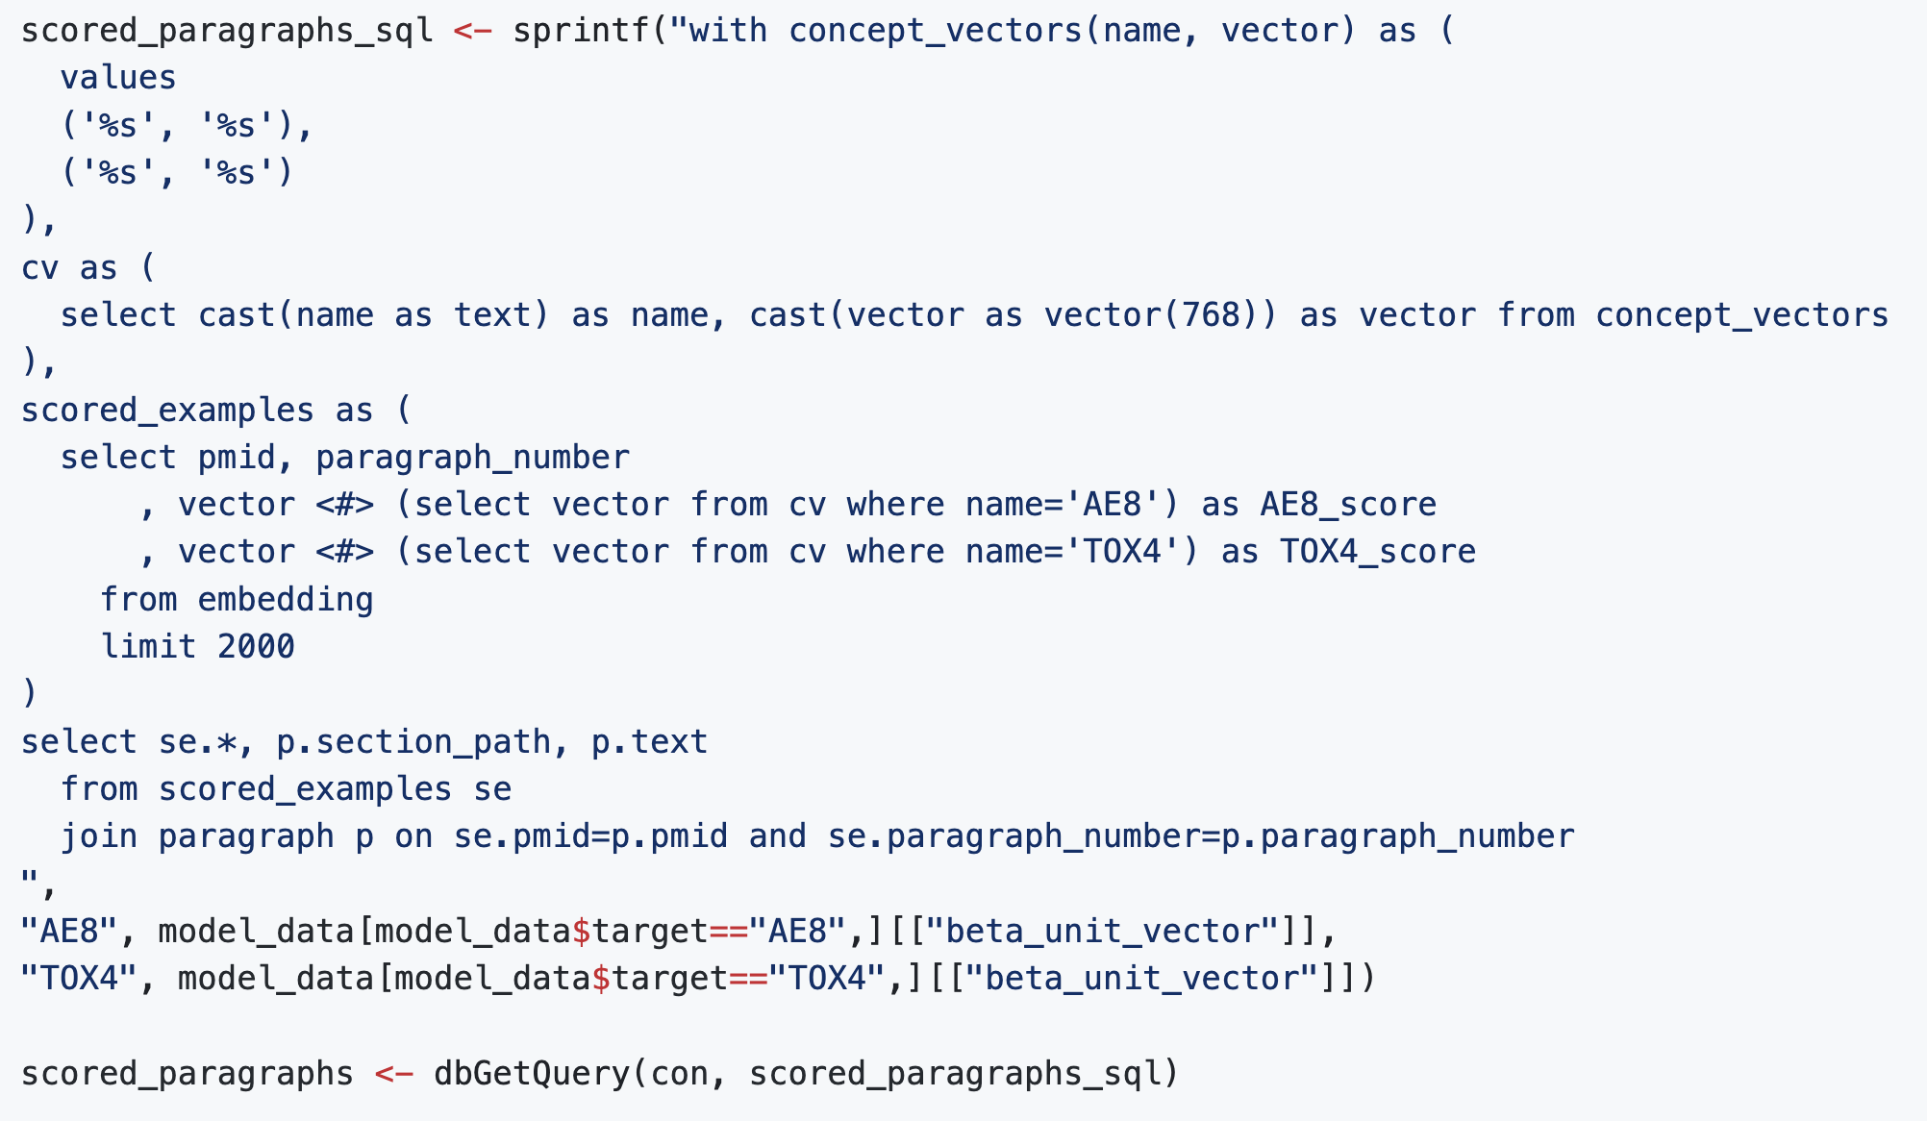
Vector search
I foolishly named my
vector columns 'vector'
There is also a data type named 'vector'
Inner product of two vectors

Slide 30
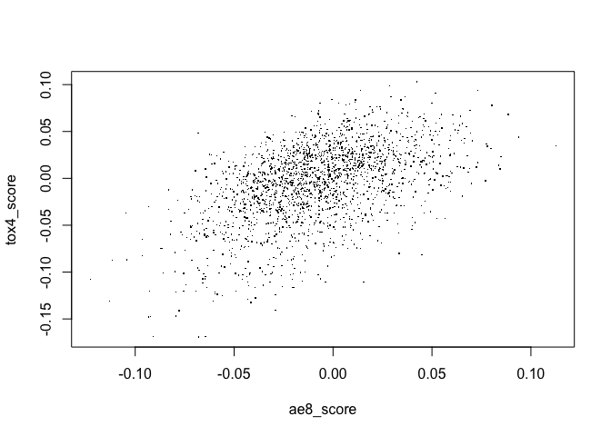
with(scored_paragraphs, plot(ae8_score, tox4_score, pch='.'))
tox4_minus_ae8 <- scored_paragraphs %>% arrange(tox4_score - ae8_score) %>% head(20)
See workbook 'section_heading_patterns_results.xlsx', sheet 'tox4_minus_ae8'

Slide 31
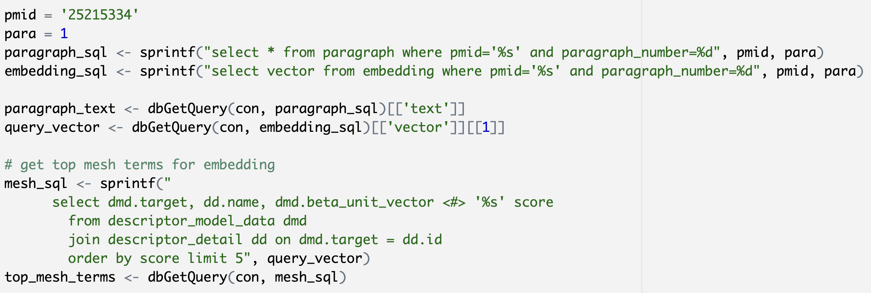
Find the top MeSH terms for a paragraph

Slide 32
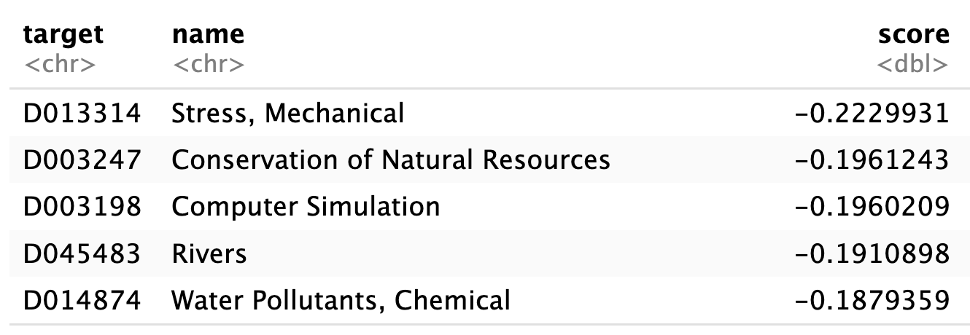
Find the top MeSH terms for a paragraph
"Most coastal structures have been built in surf zones to protect coastal areas. In general, the transformation of waves in the surf zone is quite complicated and numerous hazards to coastal communities may be associated with such phenomena. Therefore, the behavior of waves in the surf zone should be carefully analyzed and predicted. Furthermore, an accurate analysis of deformed waves around coastal structures is directly related to the construction of economically sound and safe coastal structures because wave height plays an important role in determining the weight and shape of a levee body or armoring material. In this study, a numerical model using a large eddy simulation is employed to predict the runup heights of nonlinear waves that passed a submerged structure in the surf zone. Reduced runup heights are also predicted, and their characteristics in terms of wave reflection, transmission, and dissipation coefficients are investigated."

Slide 33
How would you find the top matching paragraphs for a MeSH term?

Slide 34
Predicting MeSH Terms
Katherine Gundling, MD

Slide 35
Selected MeSH terms added in 2022
Health Inequities: Differences in health status and in the distribution of health resources between different population groups, arising from the social conditions in which people are born, grow, live, work and age.
Brain-Gut Axis: An interactive network between the GASTROINTESTINAL TRACT (gut) and the brain principally mediated through the ENTERIC NERVOUS SYSTEM. Control of the gut activities during stress, for instance, is mediated by activation of neuroendocrine hormones (e.g., CORTICOTROPIN-RELEASING FACTOR). Conversely, INTESTINAL MICROBIOTA associate with the CENTRAL NERVOUS SYSTEM through the axis via microorganism-derived products (e.g., UROCORTINS). Some functional GASTROINTESTINAL DISORDERS (e.g., IRRITABLE BOWEL SYNDROME) have dysregulated brain-gut axis.
mRNA Vaccines: Vaccines formulated with recombinant mRNAs which are taken up by the host cells that translate the mRNA and present the translated proteins to the immune system as antigens in a manner similar to that which would occur during natural infection. This induces humoral and cellular immune responses against the encoded antigen.

Slide 36
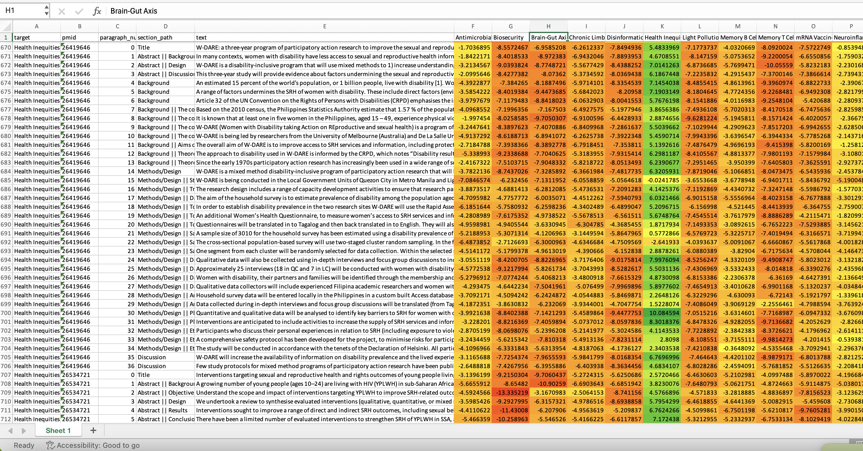

Slide 37
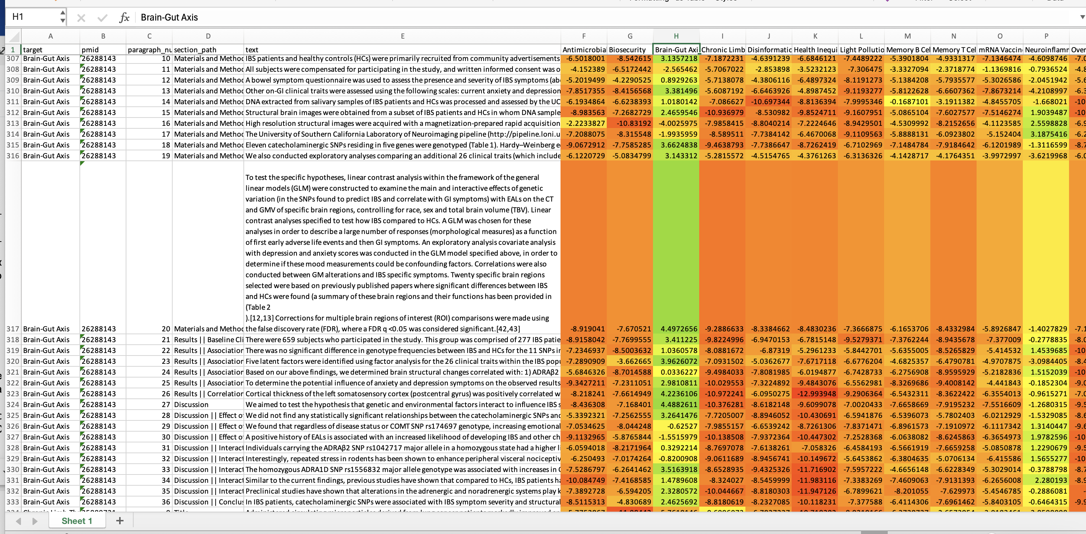

Slide 38
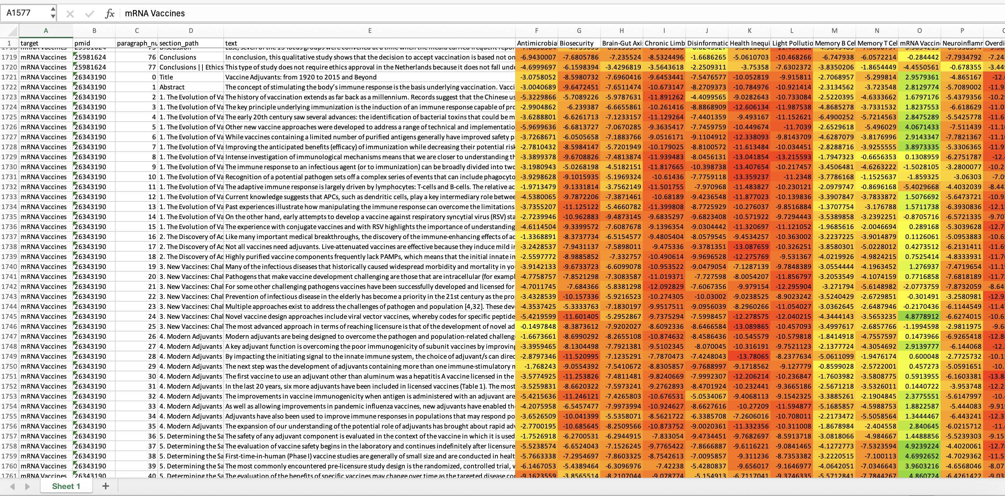

Slide 39
What did the models find in 2015 articles?
Health Inequities:
Brain-Gut Axis:
High scores generally were about interactions between gut and CNS.
Moderate scores were often about CNS or gut, but not both.
mRNA Vaccines:
Overwhelmingly finds articles about clinical trials of vaccines, or measuring responses to vaccines.
Example of bias in training data: postpandemic articles tagged with mRNA vaccines are mostly clinical trials of Covid-19 vaccines, even though the definition of the term is biochemical.
Not good at finding basic research articles.

Slide 40
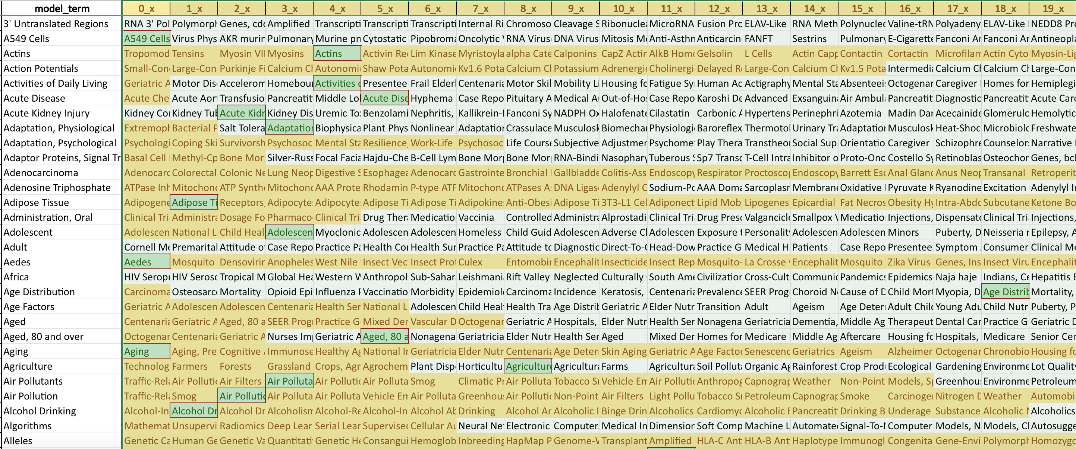
Models vs. Definitions

Slide 41
Next steps

Slide 42
Goals
Assess and document biases in MeSH term models
Train models on big datasets using GPU
How many MeSH terms can we predict reasonably?
Interpretable representation in 'MeSH term space'

Slide 43
Issues
Exploding coefficients in glmnet
Some records lost on XML import
Text not recovered from all markup languages (e.g., LaTeX)
Did not capture additional data from XML (filters for clinical trials, etc)
Dataset not kept up-to-date
Ignoring descriptor::qualifier interaction
MeSH term negative controls may have sampling bias

Slide 44
Theoretical Background on Representing Concepts with Coefficient Vectors
John Mount, PhD

Slide 45
Small Example
Sample of data taken from Pubmed central
Queried on “vaccine allergy” and one year’s results from November 2023
Paragraphs from same paper all in test or all in training
https://github.com/rmhorton/PMC_classifiers/tree/main
Paragraphs encoded into 768 dimension unit norm semantic vectors using all-mpnet-base-v2 sentence transformer
Used regexp pattern match on section path metadata as example or notional ground truth
Trained a model trying to match truth on the embedding
45269 paragraphs used for model training
29263 paragraphs used for hold out model evaluation (test)

Slide 46
Model details
Regularized logistic regression supplied by the R glmnet package
alpha set to 0 to select L2 regularization
Shrinks solution to small coefficients
Sort of a “frequentist version” to “small effect priors”
Tends to make similar features get similar model coefficients
Regularization strength (lambda) found by cv.glmnet() procedure
Model minimizes a combination of training deviance and coefficient norm
Regularization trades away training performance of smaller coefficients
If regularization is chosen without out of sample methods (such as cross validation) will always choose “no regularization”!
Choose regularization strength that maximizes simulated out of training sample performance as measured by AUC.
For more details, please see “Practical Data Science with R” 2nd edition.

Slide 47
Purpose of Demo
Rehearse Learning and Apply a Model to new Data
Learning a concept in “text embedding space” from examples
It is irrelevant that the example concept is generated by a regular expression. Real training examples can come from curation, and meta data.
Show how semantic concepts can be learned from examples
Extreme value of the text embedding space
Simplicity of linear classifier over embedding features
PubMed just a very well curated example with semantic tags to train on
(side benefit) Applying the above semantic model to additional papers (or paragraphs)
Could be new papers to be tagged
Could be papers produced prior to a mesh term being defined.

Slide 48
Demo Evaluation
Receiver Operator Characteristic curve (ROC)
A graph that concisely shows every efficient trade off between 1-specificity (false positive rate) and sensitivity (true positive rate or recall) available by applying a different comparison threshold to convert the model’s score into a decision.
AUC is “area under the curve” portrayed in the ROC plot.
AUC 1 is perfect
AUC 0.5 is useless (can be achieved by random guessing)

Slide 49
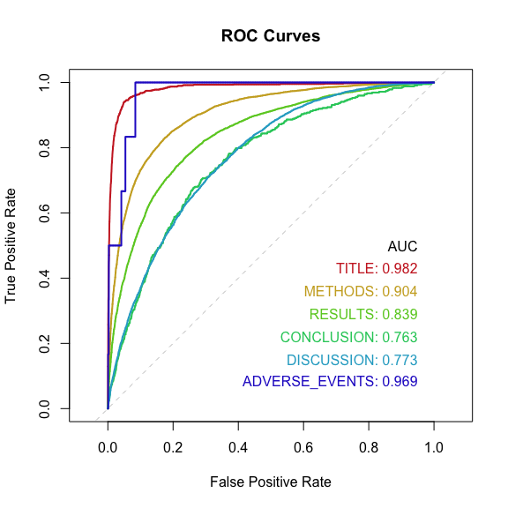
Demo Performance (Out of Sample, or Test)
Notes:
Jumps in ROC curve are typical of concepts with very few examples.

Slide 50
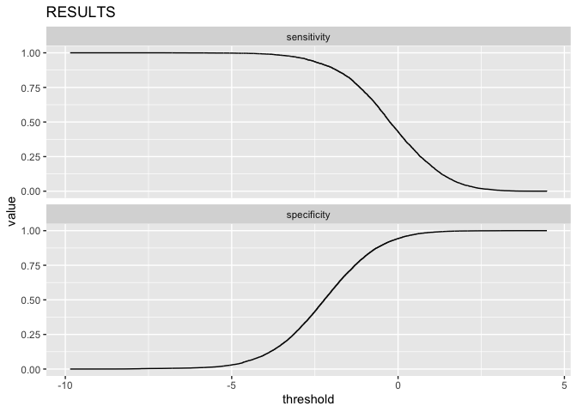
Unrolling an ROC curve (more information)

Slide 51
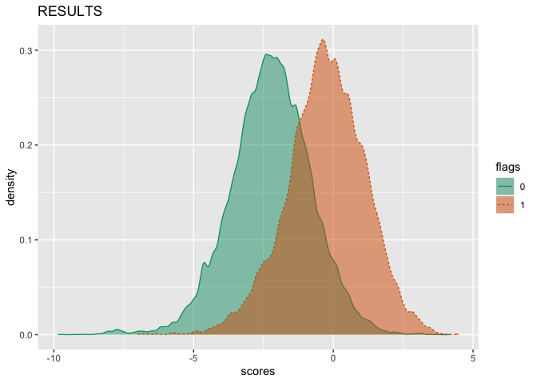
ROC is characterizing all cuts on this per-class normalized double density

Slide 52
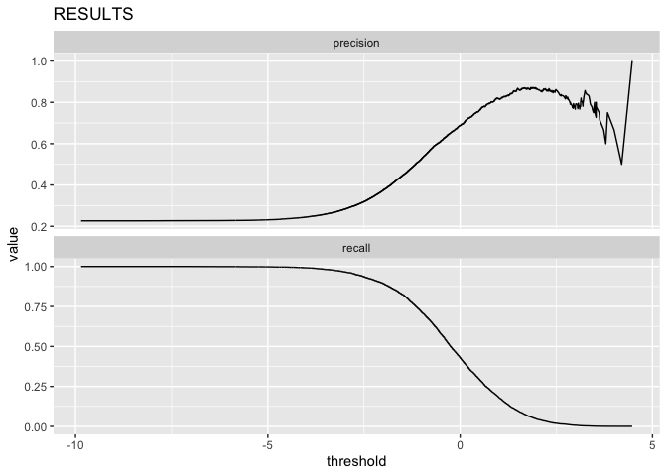
Users experience precision (recall=sensitivity)

Slide 53
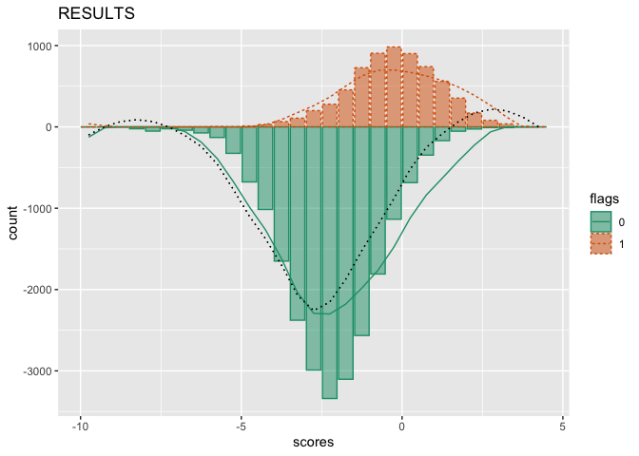
Trading precision for recall is picking a good cut on this not-normalized dual histogram

Slide 54
Advice
Never share only a prediction
Always share a model score or even better a probability.
Allows re-tuning of application if costs or prevalence changes

Slide 55
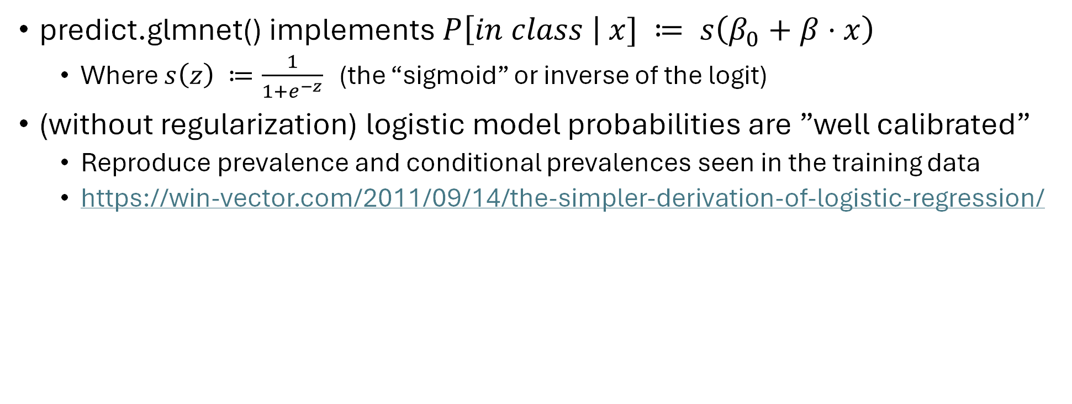
Logistic Model Structure
predict.glmnet() implements $P\left[in class \right| x] ≔ s\left(β_{0}+β⋅x\right)$
Where $s\left(z\right) ≔\frac{1}{1+e^{−z}}$ (the “sigmoid” or inverse of the logit)
(without regularization) logistic model probabilities are ”well calibrated”
Reproduce prevalence and conditional prevalences seen in the training data
https://win-vector.com/2011/09/14/the-simpler-derivation-of-logistic-regression/

Slide 56
A Cool Trick
Instead of $P\left[in class \right|x]= s\left(β_{0}+β⋅x\right)$ as your prediction, consider the following.
Define b$≔\frac{β}{{\left|\left|β\right|\right|}_{2}}$
Use $l\left(x\right) ≔ b⋅x$ as your model score.
Once we have $β$ and $b$, it no longer matters how they were fit- just how well they sort the target class from the chaff.
Consequences
$P\left[in class \right| x]$ and $l\left(x\right)$ are “order identical”
$P\left[in class \right| x]$ > $P\left[in class \right| y]$ if and only if $l\left(x\right)>l\left(y\right)$
Can build the exact same decision procedure for each (with different encoding of decision threshold).
Each generates the exact same ROC plot and produces the same AUC.

Slide 57
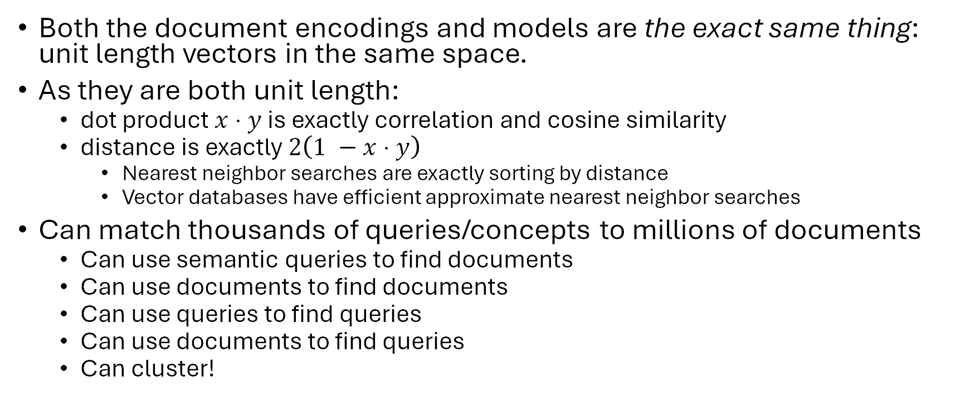
Advantages of the Trick
Both the document encodings and models are the exact same thing: unit length vectors in the same space.
As they are both unit length:
dot product $x⋅y$ is exactly correlation and cosine similarity
distance is exactly $2\left(1 −x⋅y\right)$
Nearest neighbor searches are exactly sorting by distance
Vector databases have efficient approximate nearest neighbor searches
Can match thousands of queries/concepts to millions of documents
Can use semantic queries to find documents
Can use documents to find documents
Can use queries to find queries
Can use documents to find queries
Can cluster!

Slide 58
Demo Take away
Can also do this
With better curated concepts
With much more data (how later in talk)
All code and data shared:
https://github.com/rmhorton/PMC_classifiers/tree/main/mini_demo
Download it, run it, and modify it on your own.
Only the small(ish) demo dataset is on our Github repo, but all the data is freely available from the National Library of Medicine.
Methodology can be run at large scale simultaneously matching many query concepts and paragraphs.

